Slide 1

UNIVERSITI TEKNOLOGI MALAYSIA
Research on Soil Environmental and Health Risk Analysis Based on Machine Learning

Slide 2

Research Background and Problem

Slide 3
Research Background and Problem
Soil Pollution and Health Impacts
Heavy metals, pesticide residues, and industrial waste accumulate in soil, contaminating crops and entering the food chain. This leads to chronic diseases like neurological disorders and cancer. For instance, children are 4-5 times more susceptible to lead exposure via soil-plant pathways, highlighting the urgency of risk assessment.

Slide 4
Research Background and Problem
Limitations of Traditional Approaches
Conventional methods rely on isolated data sources (e.g., solely soil heavy metals or disease records), failing to integrate multi-dimensional factors like soil pH, meteorological conditions, and industrial distribution. A case study showed that ignoring irrigation patterns caused a 30% deviation in cadmium risk assessment.

Slide 5
Research Background and Problem
Core Research Questions
How can machine learning integrate soil, environmental, and health data for spatial risk modeling?
What are the spatial correlations between pollutant concentrations, weather, and disease incidence?
Which models best identify high-risk zones?

Slide 6
Methodology and Framework

Slide 7
Methodology and Framework
Multi-source Data Integration
We utilized a Kaggle dataset (2023-2024) with 3,000 samples and 24 variables:
Environmental data: Heavy metal concentrations, pH, precipitation
Industrial-agricultural data: Factory types, fertilizer usage
Health data: Disease types, age demographics
Data Preprocessing Pipeline
Cleaning: KNN imputation for missing "Nearby Industry" data; dropping features with >50% missing values.
Feature Engineering: Creating interaction terms (e.g., Pollutant Concentration × Soil pH), seasonal encoding.
Outlier Handling: Identifying extreme values via IQR method (3% of samples corrected).

Slide 8
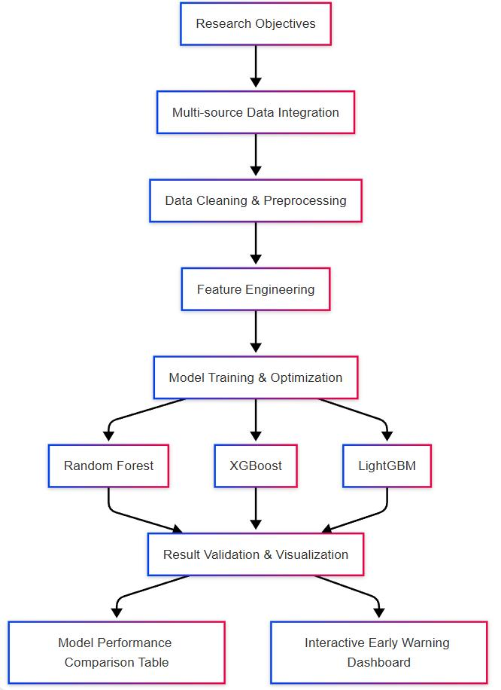
Framework

Slide 9
Experimental Results and Analysis

Slide 10
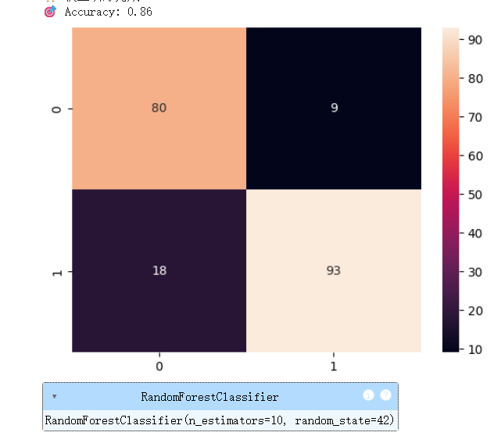
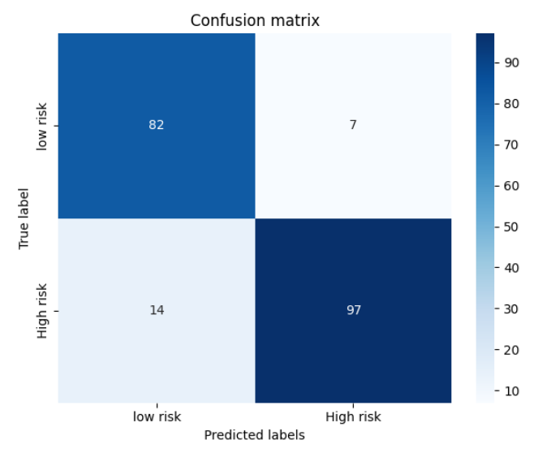
Experimental Results and Analysis
Model Performance Comparison
RF achieved 0.91 accuracy after hyperparameter tuning (max depth=10, n_estimators=200).
XGBoost showed an AUC-ROC of 0.95, with 87.4% recall in high-risk identification (97/111 true positives, 14 false negatives).

Slide 11
Experimental Results and Analysis
High-risk Case Studies
Sample 103 (100% risk probability): Dominated by lead concentration (0.405) and soil pH (6.8), where acidic conditions enhance metal bioavailability.
Sample 114 (99.99% risk probability): Low organic matter (0.158) combined with high cadmium (0.557) reduces heavy metal adsorption, verifying theoretical mechanisms.
Policy Implications
Recommend dual monitoring of soil and health in industrial zones (e.g., banning edible crop planting within 5 km of lead-zinc smelters).
Propose developing an early-warning dashboard to alert areas with pH<5.5 and cadmium>0.3mg/kg.

Slide 12
Conclusions and Future Work

Slide 13
Conclusions and Future Work
Research Contributions
Established a multi-source data-driven framework, overcoming traditional single-source analysis limitations.
Validated the superiority of XGBoost and RF in capturing nonlinear pollution-health relationships for precise risk prediction.
Limitations and Future Directions
Current lack of real-time monitoring data; future integration of IoT sensor networks.
Plan to enhance model interpretability using SHAP values for policy-makers.
Pursue cross-regional validation (e.g., comparing Southeast Asia vs. Europe soil pollution risks).
Closing Acknowledgments
I would like to thank my supervisor for methodological guidance and my team for data collection support. This research provides a novel technical pathway for soil pollution prevention. I welcome further discussions on its practical applications.

Slide 14


THANK YOU
utmofficial
univteknologimalaysia
utm.my

